Slide 1
Spark BigDL
© Intel
Slides based heavily on those by Jason Dai and Ding Ding, taken from AI Conference 2017 San Francisco

Slide 2
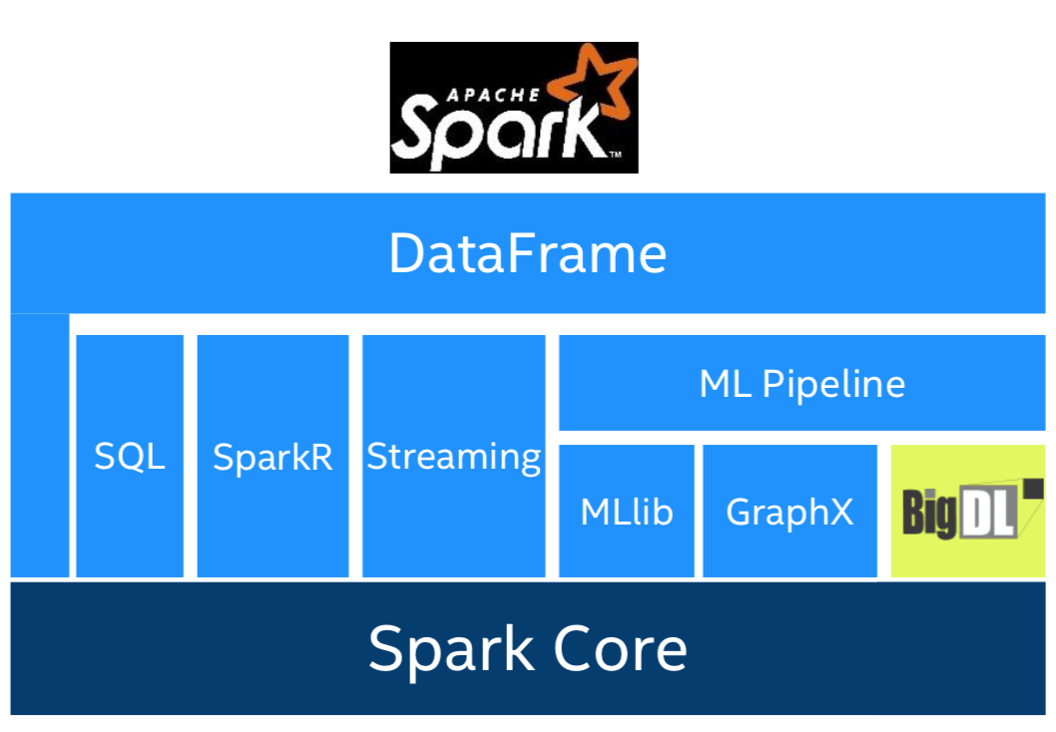
What is BigDL?
BigDL is a deep learning library built for Apache Spark
Make deep learning more accessible
Write deep learning applications as standard Spark programs
Run on existing Spark/Hadoop clusters (no changes needed)
Feature parity with Caffe, Torch, TensorFlow
High-performance Intel MKL library in tasks, efficient all-reduce and SGD at scale
Works with pre-trained Keras, Caffe, or Torch models

Slide 3
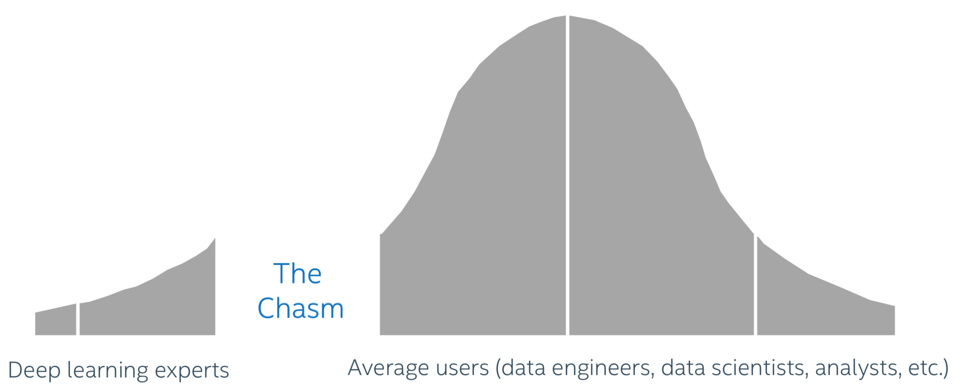
Making deep learning accessible

Slide 4
BigDL’s Goals
Make deep learning more accessible to big data and data science communities
Continue the use of familiar software tools (Spark) and hardware infrastructure (Hadoop clusters) to build deep learning applications
Analyze “big data” using deep learning on the same Hadoop/Spark cluster where the data are stored
Add deep learning functionalities to the Big Data (Spark) programs and/or workflow
Leverage existing Hadoop/Spark clusters to run deep learning applications
Shared with other workloads (e.g., ETL, data warehouse, feature engineering, statistic machine learning, graph analytics, etc.) in a dynamic and elastic fashion

Slide 5
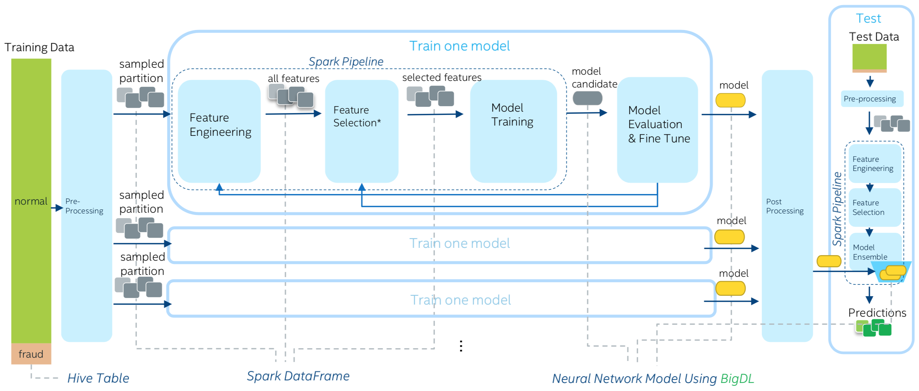
Case Study: Fraud Detection for UnionPay
https://mp.weixin.qq.com/s?__biz=MzI3NDAwNDUwNg==&mid=2648307335&idx=1&sn=8eb9f63eaf2e40e24a90601b9cc03d1f

Slide 6
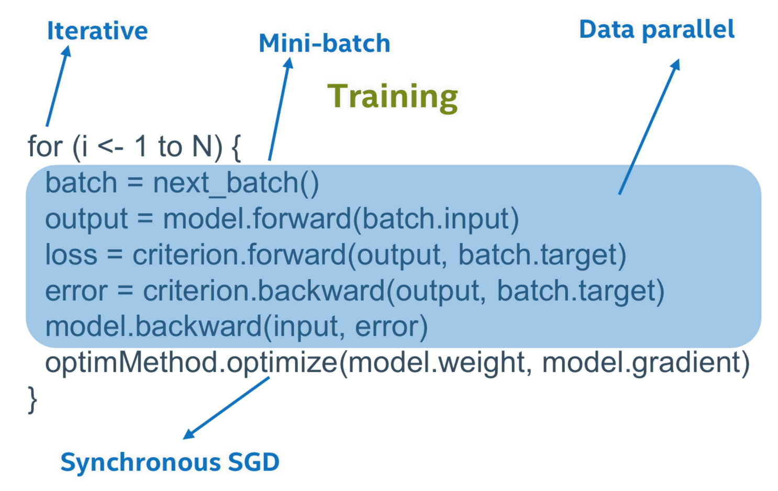
Distributed Training in BigDL
“Data parallel” vs “Model parallel”
Runtime complexity

Slide 7
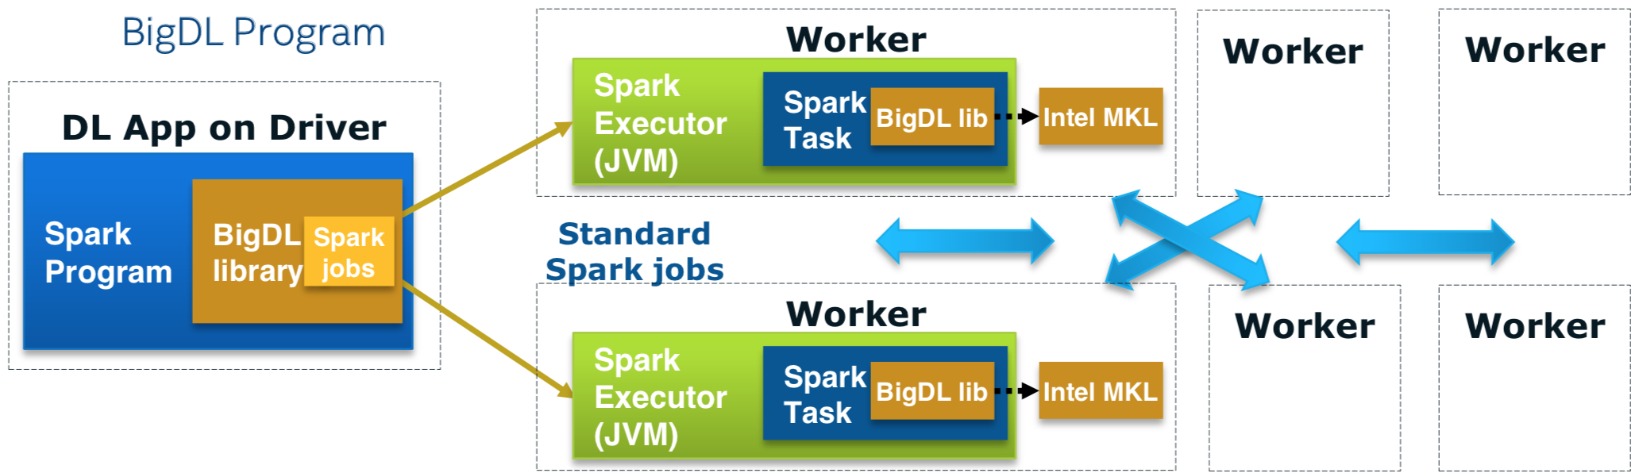
Run as a standard Spark program
Standard Spark jobs
No changes to the Spark or Hadoop clusters needed
Iterative
Each iteration of the training runs as a Spark job
Data parallel
Each Spark task runs the same model on a subset of the data (batch)

Slide 8
Considerations in large-scale distributed training
Optimizing parameter synchronization and aggregation
Optimizing task scheduling
Scaling batch size

Slide 9
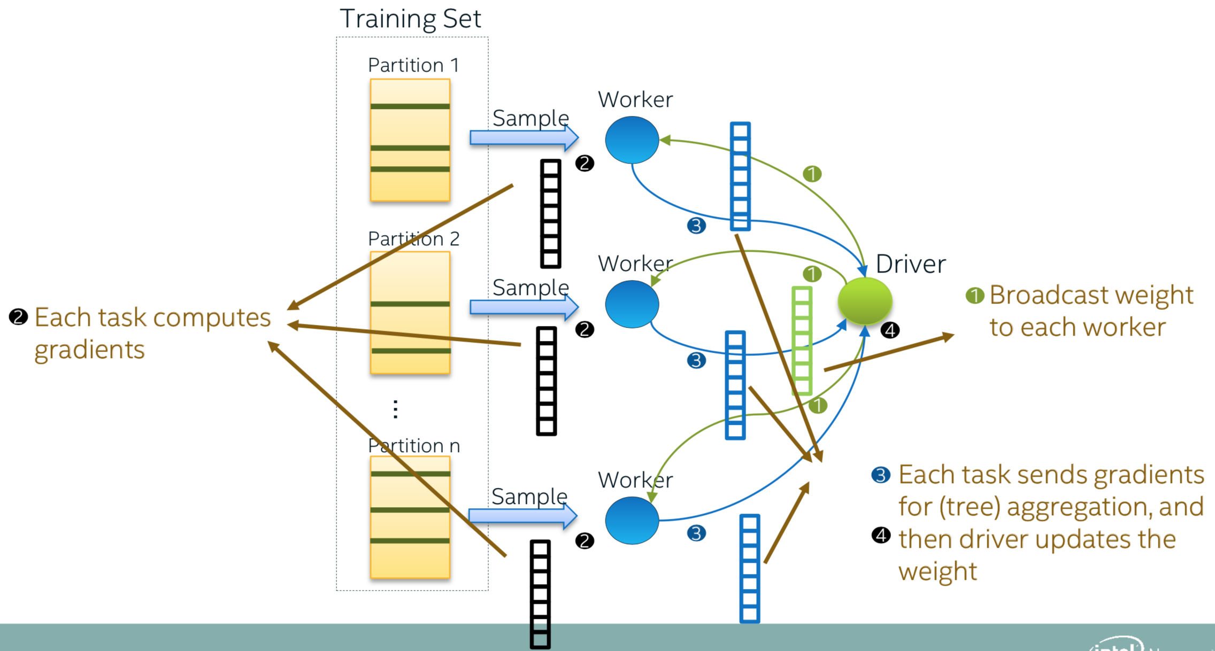
Parameter Synchronization in Spark MLlib

Slide 10
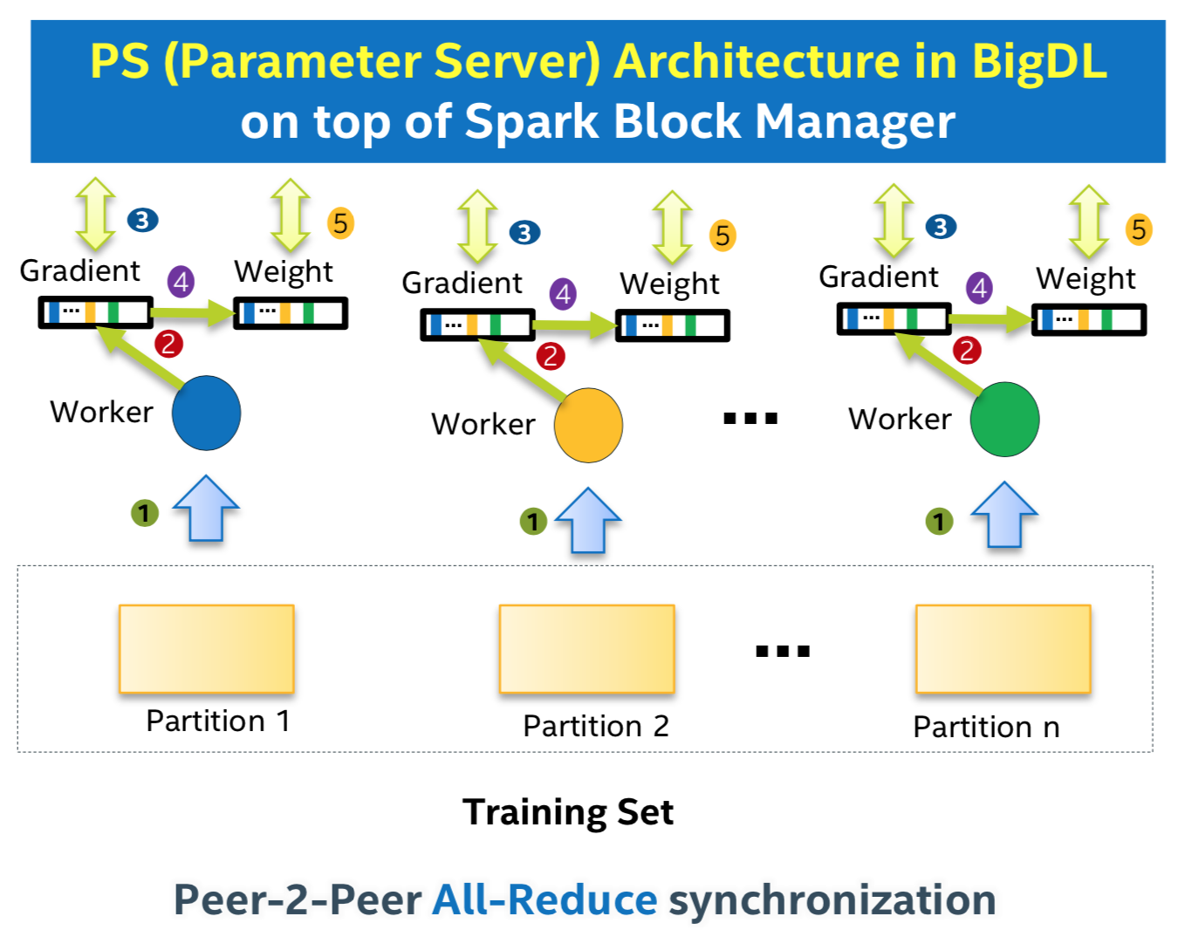
Parameter Synchronization in BigDL
Notes:
AllReduce—an MPI construct
- basically a “headless” reduce
- a reduce in a case where all the nodes are interested in the result
- essentially combines ”Reduce” with “broadcast”
- can be done easily with a parameter server

Slide 11
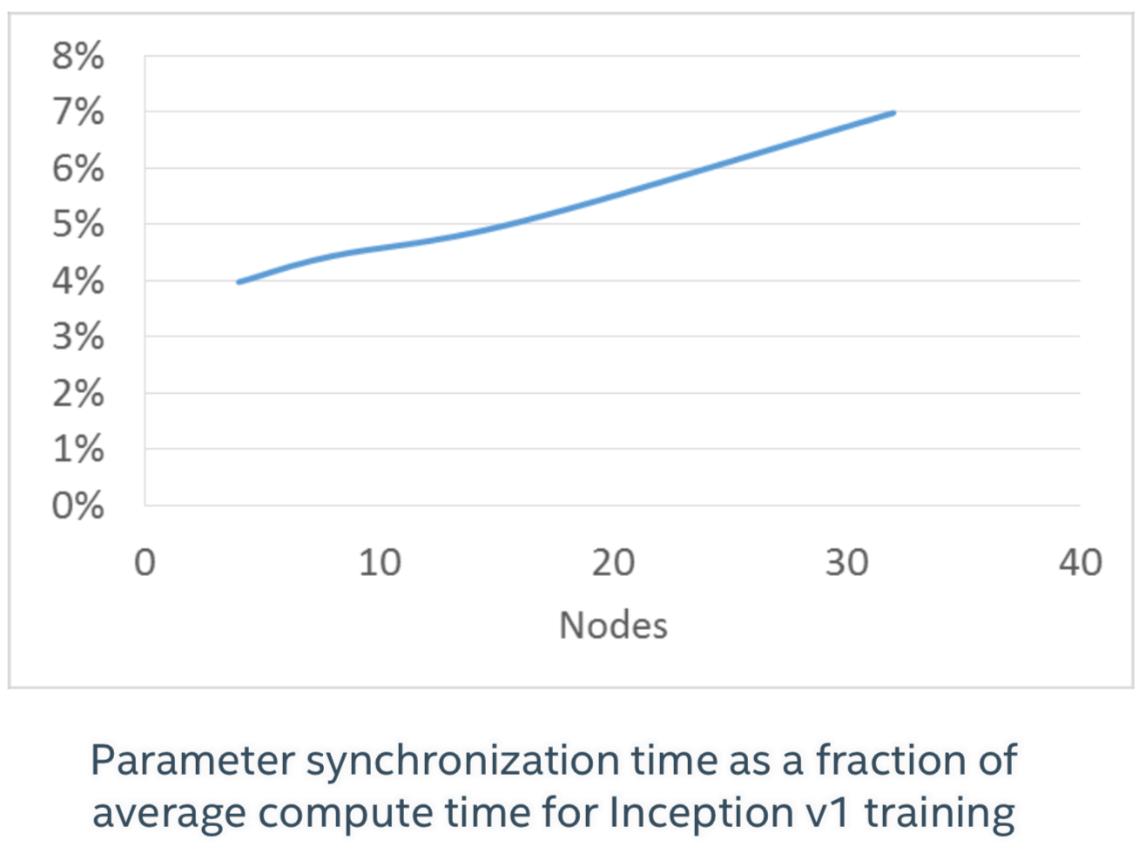
Performance of BigDL Parameter Synchronization

Slide 12
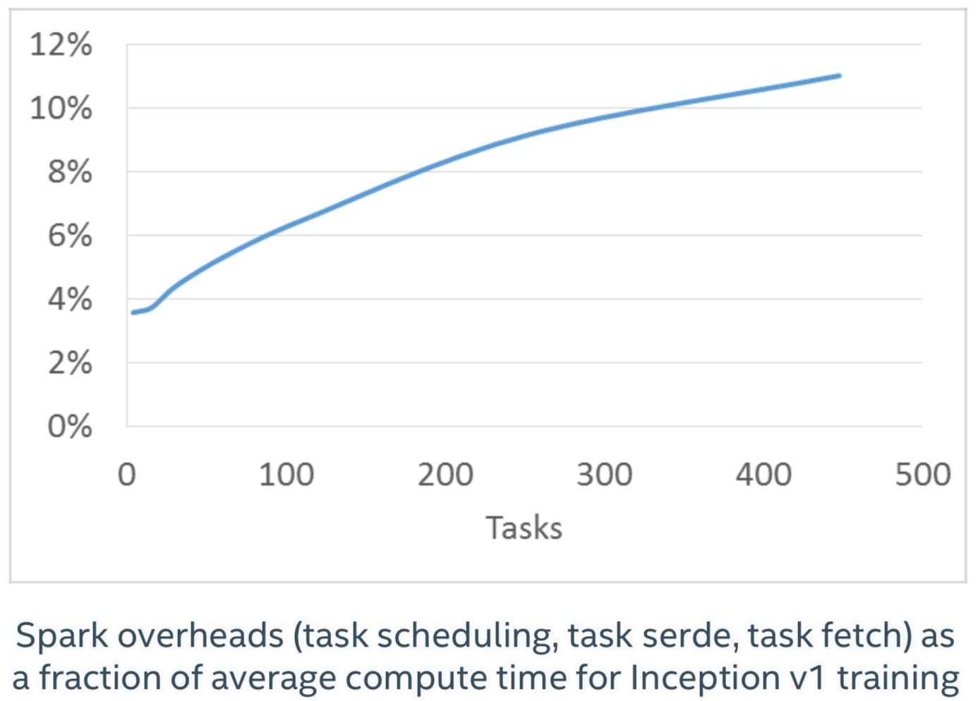
Spark Task Scheduling Overheads

Slide 13
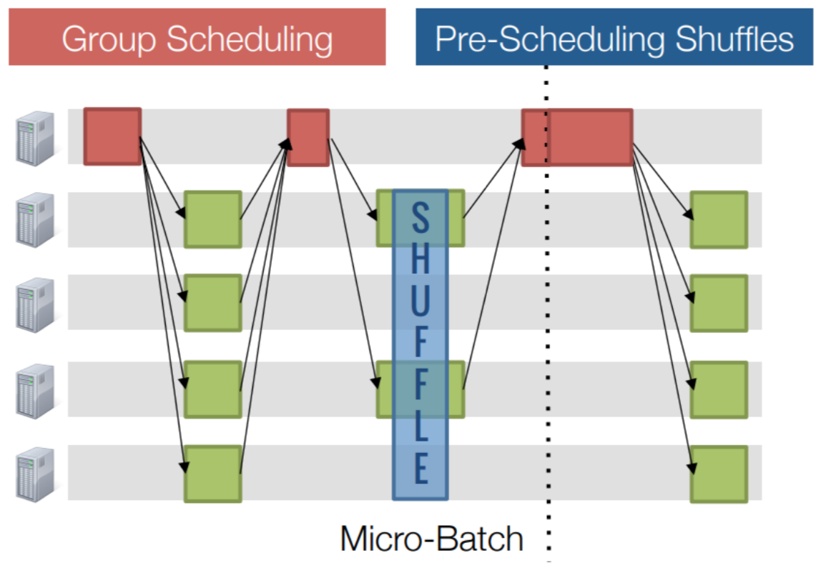
BigDL + “Drizzle”
A low-latency execution engine for Apache Spark, packaged in BigDL
Fine-grained execution with coarse-grained scheduling
Group scheduling
Scheduling a group of iterations at once
Fault tolerance, scheduling at group boundaries
Coordinating shuffles: pre-scheduling
Pre-schedule tasks on executors
Trigger tasks once dependencies are met

Slide 14
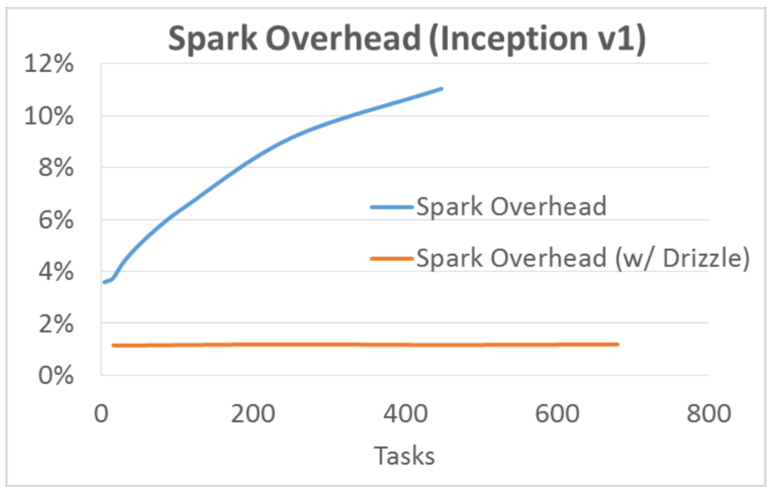
Spark Task Scheduling Overheads, Redux

Slide 15
Drizzle increases mini-batch size
Distributed synchronous mini-batch SGD
Increased mini-batch size
Can lead to loss in test accuracy
State-of-art method for scaling mini-batch size
Linear scaling rule
Warm-up
Layer-wise adaptive rate scaling
Adding batch normalization
total_batch_size = batch_size_per_worker * num_of_workers
“Accurate, Large Minibatch SGD: Training ImageNet in 1Hour”
“Scaling SGD Batch Size to 32K for ImageNet Training”

Slide 16
Want to get started?
As easy as pip install
https://bigdl-project.github.io/master/#PythonUserGuide/install-from-pip/
(add to custom Python startup script for Dataproc)
A few configuration changes to make on Dataproc, but not too bad
https://github.com/intel-analytics/BigDL/blob/master/docs/docs/ProgrammingGuide/run-on-dataproc.md

Slide 17
If you use the Java API…
Deep Learning For Java (DL4J)
https://deeplearning4j.org/
Full GPU support
Parameter server training for Spark-based applications
Requires a bit more setup and configuration
Especially if using GPUs
Phenomenal docs on getting started with deep learning theory

Slide 18
Questions?

Slide 19
References
https://bigdl-project.github.io/master/#
https://github.com/intel-analytics/BigDL/

Slide 20
Project Notes
P1 is due Thursday, February 1 at 11:59:59pm.
AutoLab shuts down, and I stop considering changes on GitHub
P2 will be released on Thursday!
AutoLab assignment will show up
Teams will be announced on Slack
Due Thursday, February 15 (2 weeks) at 11:59:59pm.
P1 Lightning Talks next Wednesday!
Each team gives a 5-minute overview of their work (slides please)
Highlight the approach you took (theory, engineering, teamwork) and how it paid off (or not)—what worked, what didn’t, what you’d keep, what you’d change
Teams will be called up randomly, so be ready to go!

